Slide 1

Big Mountain Resort
Executive Presentation from Data Science Team

Slide 2
Problem statement
Should Big Mountain Resort change its price to reflect the value it provides its customers based on data collected from other resorts in its market share for the next season?
In the past, pricing strategy was to charge a premium above the average price
This doesn’t take the resorts features into account

Slide 3
Action Plan/Key Findings
Increase Prices at BMR
Current price is $81.00
Proposed Price is 95.87
Big Mountain Resort is in the top percentile of all the major categories that determine ticket price.
The features at BMR support a large increase in price for passes.

Slide 4
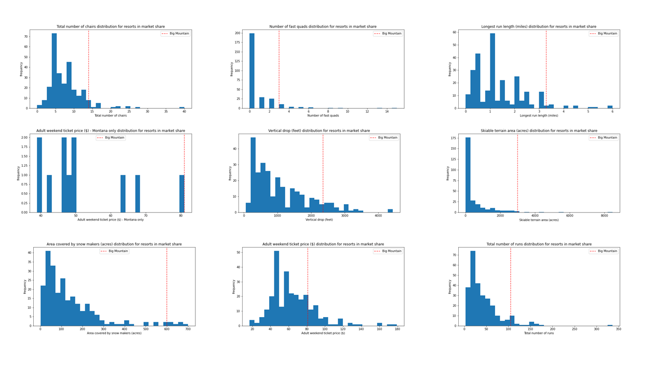
In all Categories BMR is top of its class
Redline indicates BRM in graphs

Slide 5
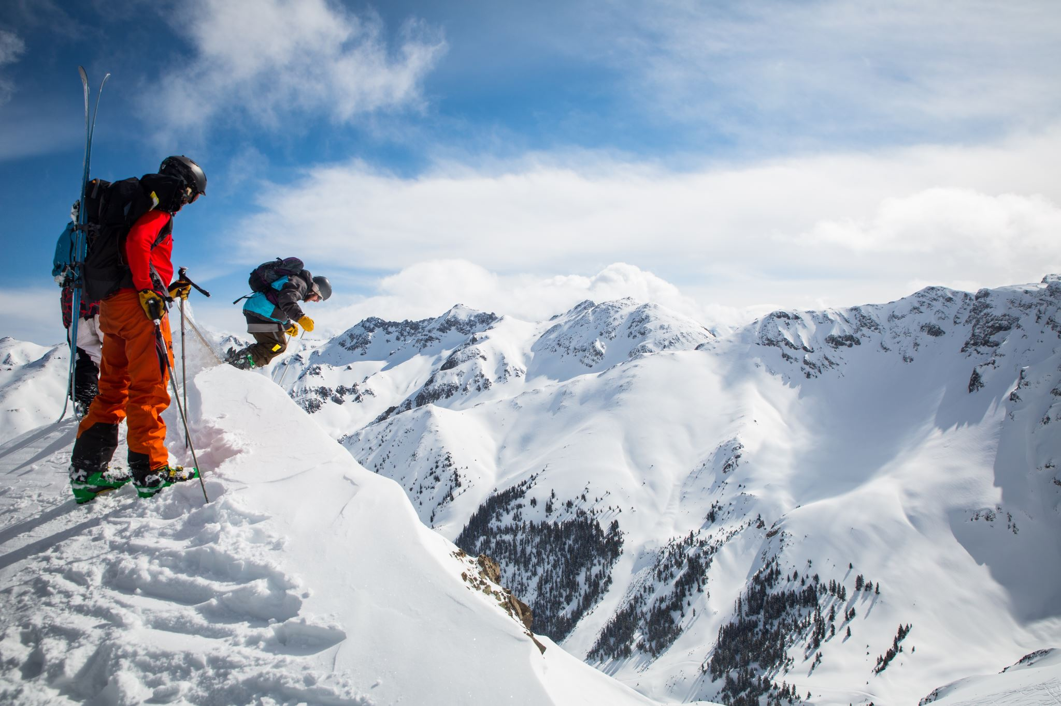
Big Mountain Resort is ready for new revenue
Should Big Mountain Resort change its price to reflect the value it provides its customers based on data collected from other resorts in its market share for the next season?
After study of 24 characteristics of 276 different ski resorts, it was found that Big Mountain Resort holds top tier amenities compared to anywhere in the country and the current business model is underestimating BMRs value to customers.

Slide 6

Big Mountain Resort
Let the data be your guide

